Slide 1

Uber Mini Project
Tejas sawant
© All rights reserved by Fireblaze Technologies Pvt. Ltd.

Slide 2
Problem Statement
To find possible insights from given Uber dataset using data visualization
© All rights reserved by Fireblaze Technologies Pvt. Ltd.

Slide 3
Proposed Solution
By using python like matplotib and Seaborn we will perform data visualization on given dataset and try to find useful insights.
© All rights reserved by Fireblaze Technologies Pvt. Ltd.

Slide 4
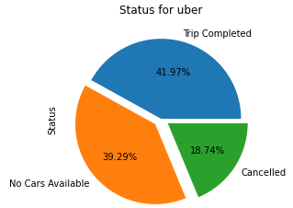
Data Analysis
Uber Status For Trips.
© All rights reserved by Fireblaze Technologies Pvt. Ltd.

Slide 5
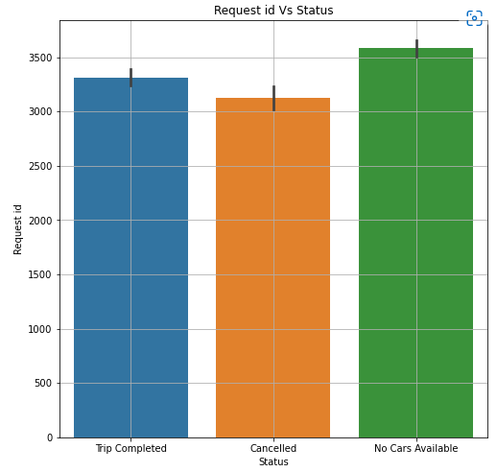
Data Visualization
Request id and Status.
© All rights reserved by Fireblaze Technologies Pvt. Ltd.

Slide 6
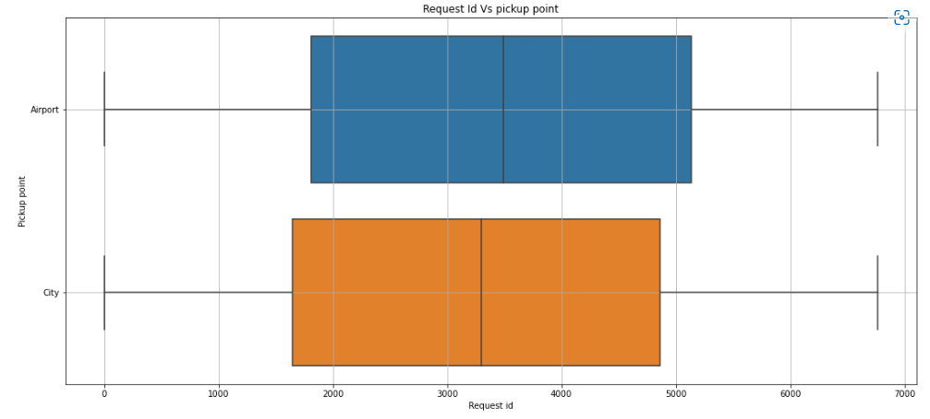
Data Visualization
pickup point and Request id
© All rights reserved by Fireblaze Technologies Pvt. Ltd.

Slide 7
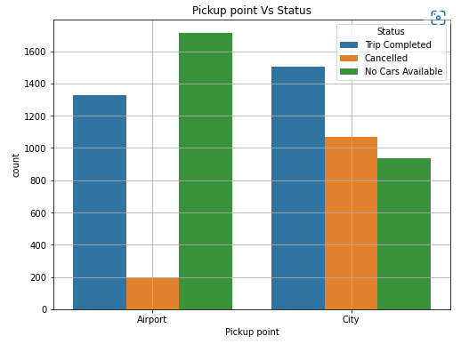
Data Visualization
Pickup Point And Status
© All rights reserved by Fireblaze Technologies Pvt. Ltd.

Slide 8
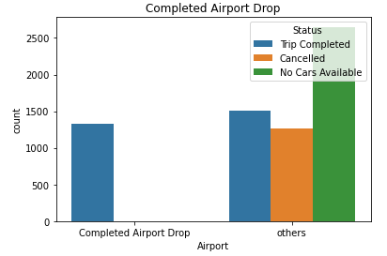
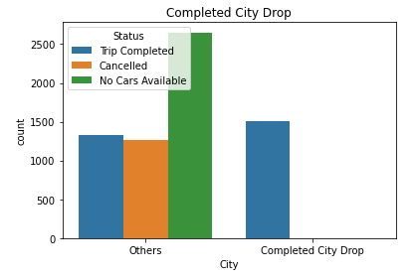
Data Visualization
Total Completed City Drop and Airport drop
© All rights reserved by Fireblaze Technologies Pvt. Ltd.

Slide 9
Disadvantage
Data is limited only two pick up point.
Diver id missing value is 39%
Drop timestamp missing value is 58%
No car available in Airport data.
© All rights reserved by Fireblaze Technologies Pvt. Ltd.

Slide 10
ADVANTAGES
Status variation pick up point can be accessed.
Derivers proportion from pick up point can be calculated.
Uber is very easy available.
Uber providing Safe rides.
© All rights reserved by Fireblaze Technologies Pvt. Ltd.

Slide 11
Conclusion
Price from city should be rationalized as cancellation is far more as compare to Airport.
Available cars on Airport pickup point.
© All rights reserved by Fireblaze Technologies Pvt. Ltd.

Slide 12
Future Scope
Cars availability should be rationalized based on weekly demand.
© All rights reserved by Fireblaze Technologies Pvt. Ltd.

